Slide 1

Design and Implementation of a Unified Data Platform for Construction Data
Organization name: Kanerika
Presented by
Dhanush V S
Roll No: 23223019
MCA- VI Semester
(Session: 2025-2026)
Dr.Tripti Swarnkar
Head
Department of Computer Applications
National Institute of Technology Raipur
Dr. Manju Pandey
Internal Guide
Department of Computer Applications
National Institute of Technology Raipur
Jaspal Rajpurohit
External Guide
Software Engineer
Kanerika
Joining date: 05/01/2026
Submission date: dd/mm/yyyy

Slide 2

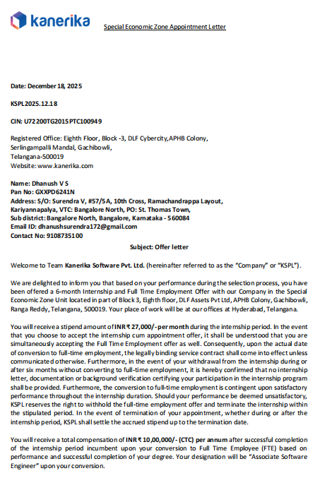
Joining Letter

Slide 3

Information About the Organization
About Kanerika
Kanerika is a global data, analytics, and AI consulting company.
The company helps organizations use data to improve business decisions and operations.
It works with modern technologies like Big Data, Artificial Intelligence, and Cloud platforms.

Slide 4
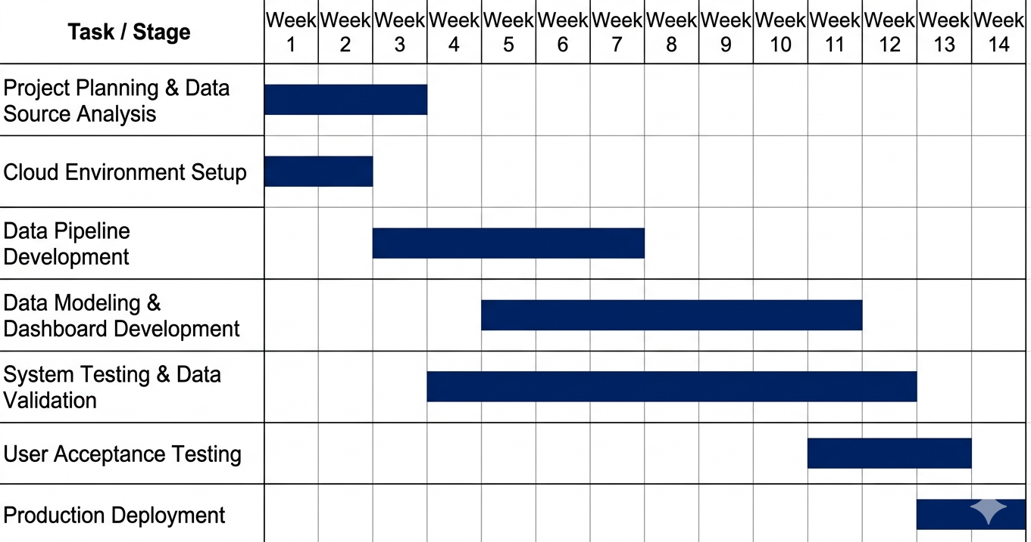
Timeline Chart

Slide 5
Training Details
During my training at Kanerika, I worked with modern data engineering and cloud technologies used in real industry projects.
Technologies learned:
Microsoft Fabric – Unified analytics platform for data integration, engineering, and analytics.
Google BigQuery – Serverless data warehouse used for large-scale SQL analytics.
Fivetran – Automated data pipeline tool used to sync data from multiple sources to data warehouses.
Google Cloud Run – Platform used to deploy and run containerized applications without managing servers.
Key learning:
Understanding how modern cloud platforms manage large-scale data pipelines and analytics workflows.

Slide 6
Programming & Development Tools
During the training I also worked with tools used in data engineering and version control.
Languages / Tools:
SQL – Used to query, transform, and analyze data in data warehouses.
Git – Used for version control and collaborative development.
Dataform – Used for building and managing SQL-based data transformation workflows in BigQuery.
Skills developed:
Writing optimized SQL queries
Managing code using Git repositories
Building structured data transformation pipelines

Slide 7
Workflow Automation & Data Pipeline Concepts
Technologies / Methods:
Google Workflows – Used to automate and orchestrate cloud services and APIs.
Google Cloud – Platform used to deploy data pipelines and cloud applications.
Concepts learned:
Data pipeline orchestration
ETL / ELT workflows
Cloud-based data architecture
Automating data processing tasks
Outcome:
This training helped me understand how companies design scalable cloud-based data engineering systems.

Slide 8
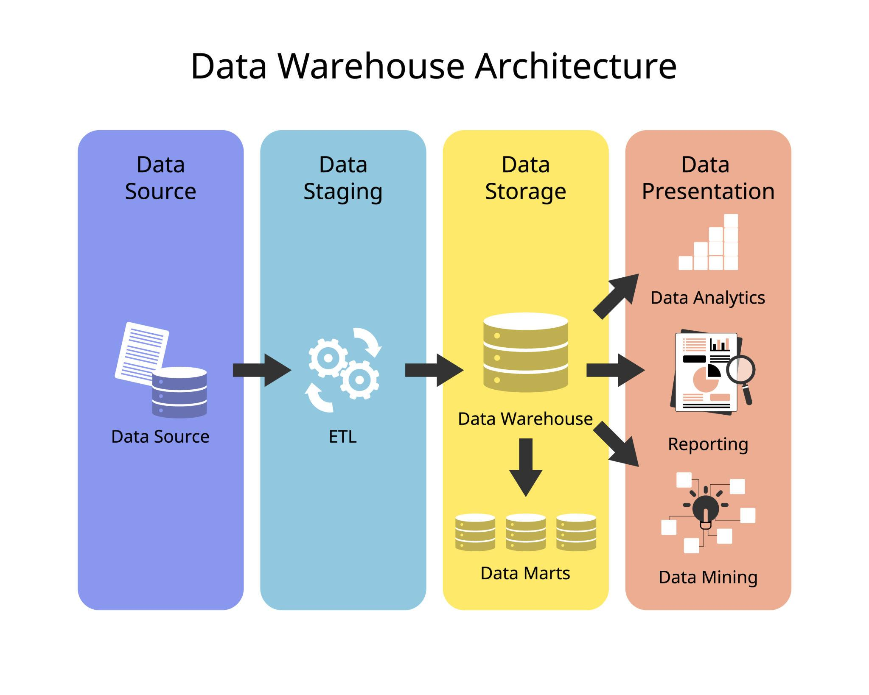
Information about Project Title and Motivation
Production data and financial data are not well connected.
There is no single view of production and sales performance.
Cost tracking and variance visibility are limited.
Many processes are manual and time-consuming.
Production and project performance tracking is inconsistent.
It is difficult to analyze trends and seasonal patterns.
Forecasting is not connected to real performance data.

Slide 9
Software Requirement Specification
Functional Requirements
Integrate data from multiple sources such as Procore, Google Sheets, and QuickBooks.
Automate data ingestion using Fivetran pipelines.
Store consolidated data in a centralized warehouse (Google BigQuery).
Transform and model data for analytical reporting.
Provide interactive dashboards and reports using Power BI.
Non-Functional Requirements
Scalability: System should handle large volumes of data.
Reliability: Automated pipelines should run consistently without failures.
Security: Controlled access to sensitive business data.
Performance: Queries and reports should load efficiently.

Slide 10
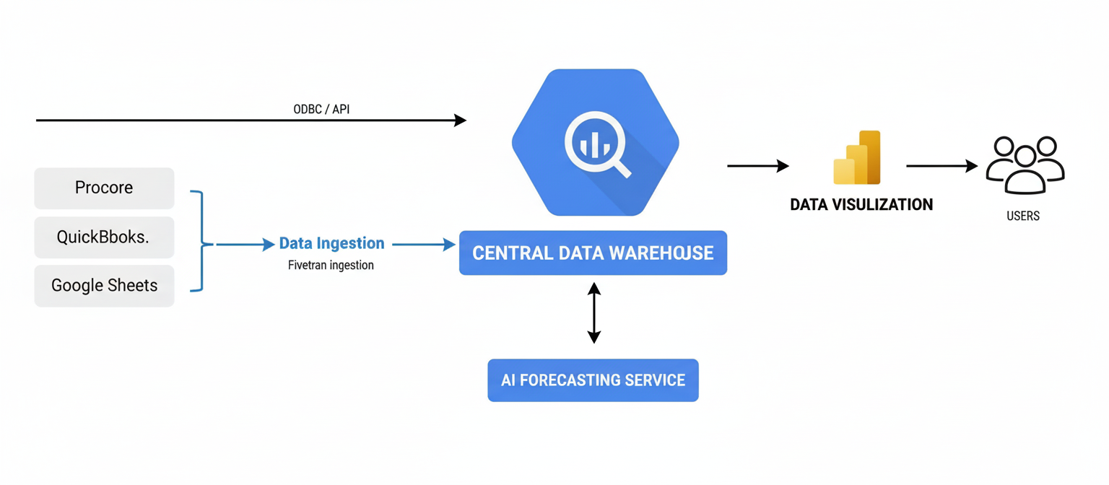
Architecture Diagram of the Project

Slide 11

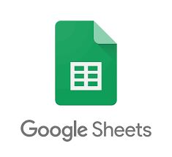

Data Source Identification and Integration
Data Sources
Procore (project and production data)
QuickBooks (financial data)
Google Sheets (operational records)
Method
Identify required datasets from each system
Connect data sources using Fivetran connectors
Automate data extraction and loading

Slide 12

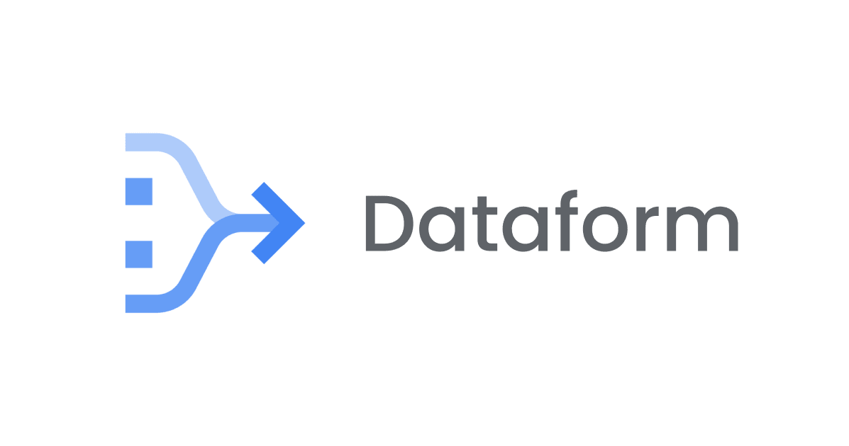

Data Processing and Storage
Process
Load raw data into Google BigQuery
Clean and standardize data
Perform data transformations
Create structured analytical tables

Slide 13

Reporting and Analytics
Process
Connect Power BI to BigQuery
Build dashboards and reports
Enable performance monitoring and insights
Outcome
Centralized reporting system
Improved visibility into production and financial performance

Slide 14
Thank You!
Q & A

